Slide 1
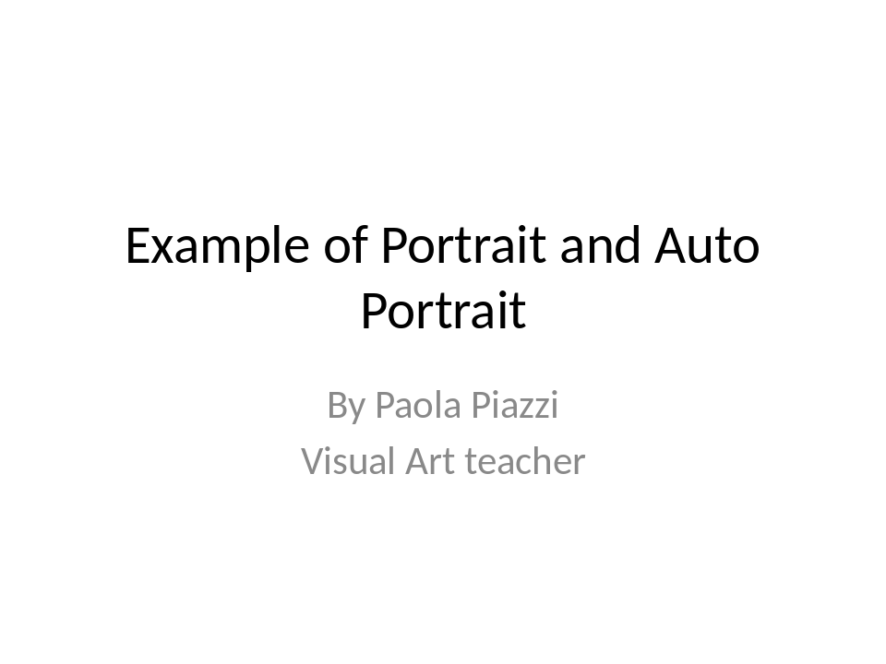
Example of Portrait and Auto Portrait
By Paola Piazzi
Visual Art teacher

Slide 2
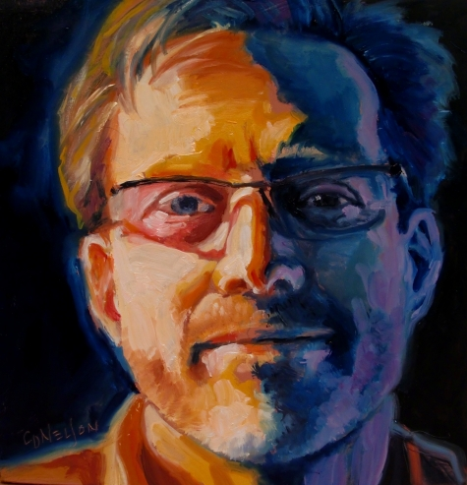
Oil_portraits Ferdinand 89
Carol_Nelson_
fine_art

Slide 3
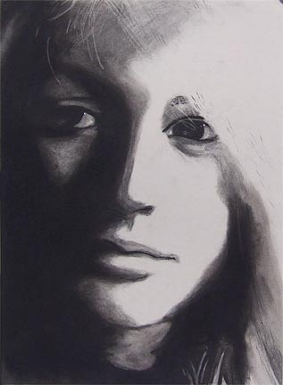
Ashleyl
Charcoal
SelfPortrait

Slide 4
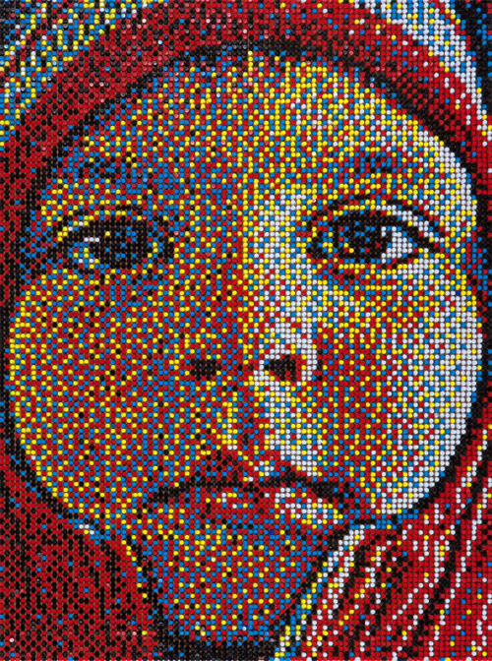
eric_daigh_03

Slide 5
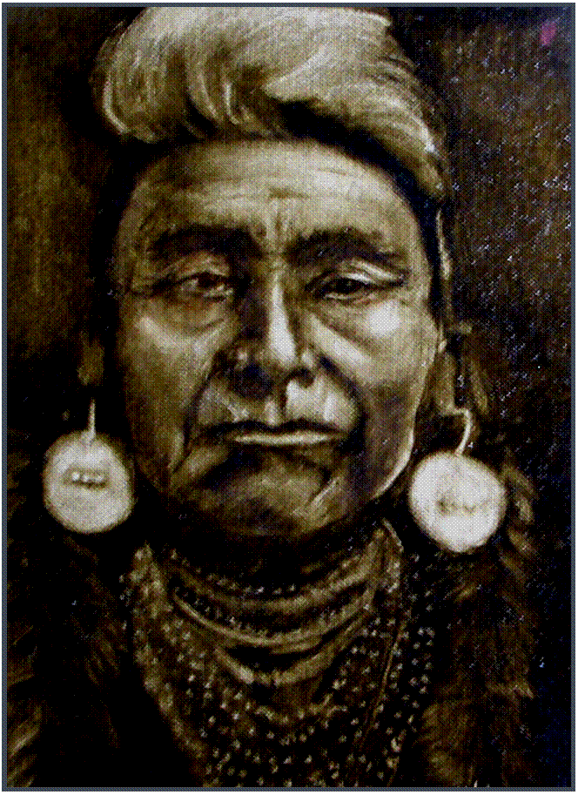
Geronimo_
Best Gift
Oil

Slide 6
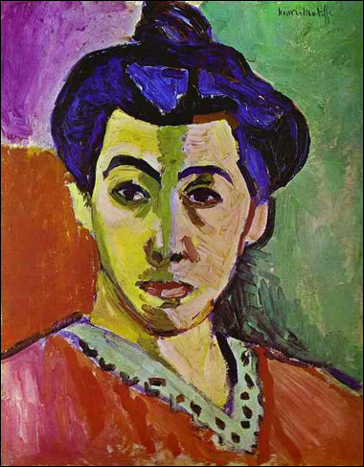
Green Stripe (Madame Matisse) By Henri Matisse

Slide 7
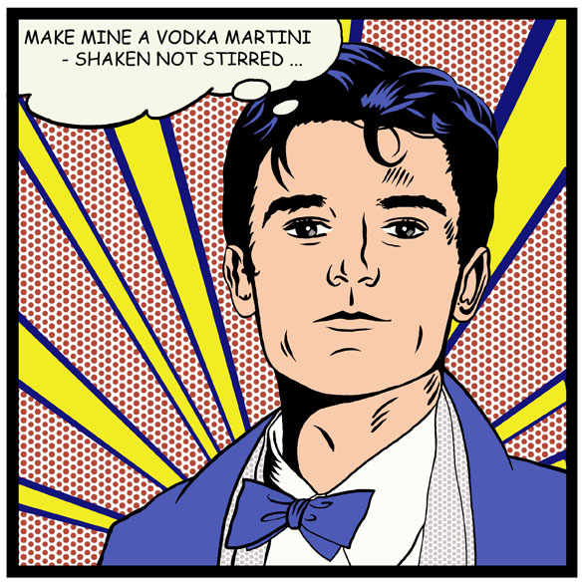
MARK-LOW-RES-copy

Slide 8
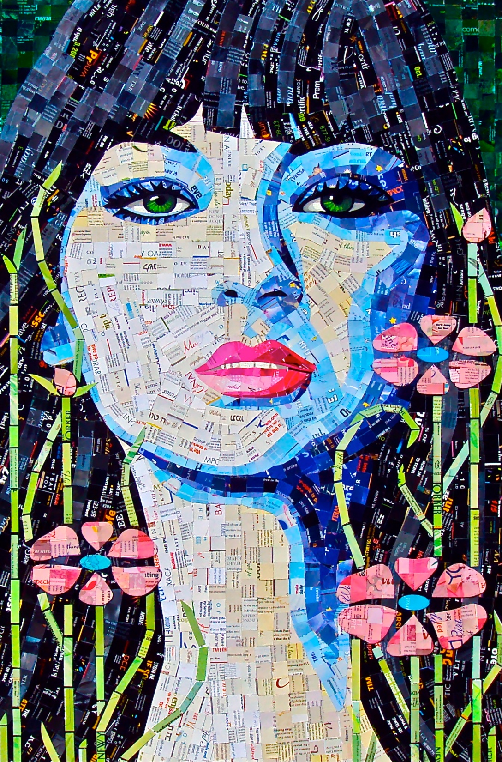
mix technique

Slide 9
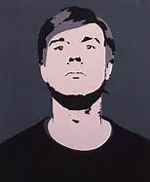
MONO color

Slide 10
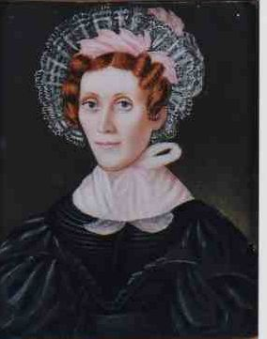
19th-C-American-Folk-Art-Portraits-In-Excellent-State-Of-Preservation-

Slide 11
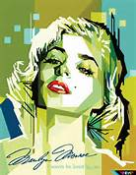
Painting Mix

Slide 12
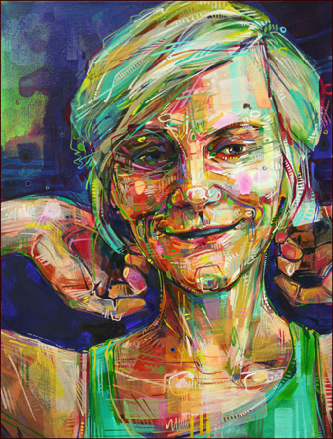
painting mix

Slide 13
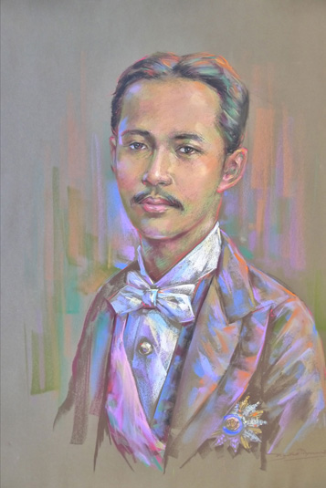
Pastels Drawing

Slide 14
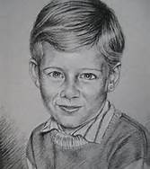
Pencil
Drawing
Portrait

Slide 15
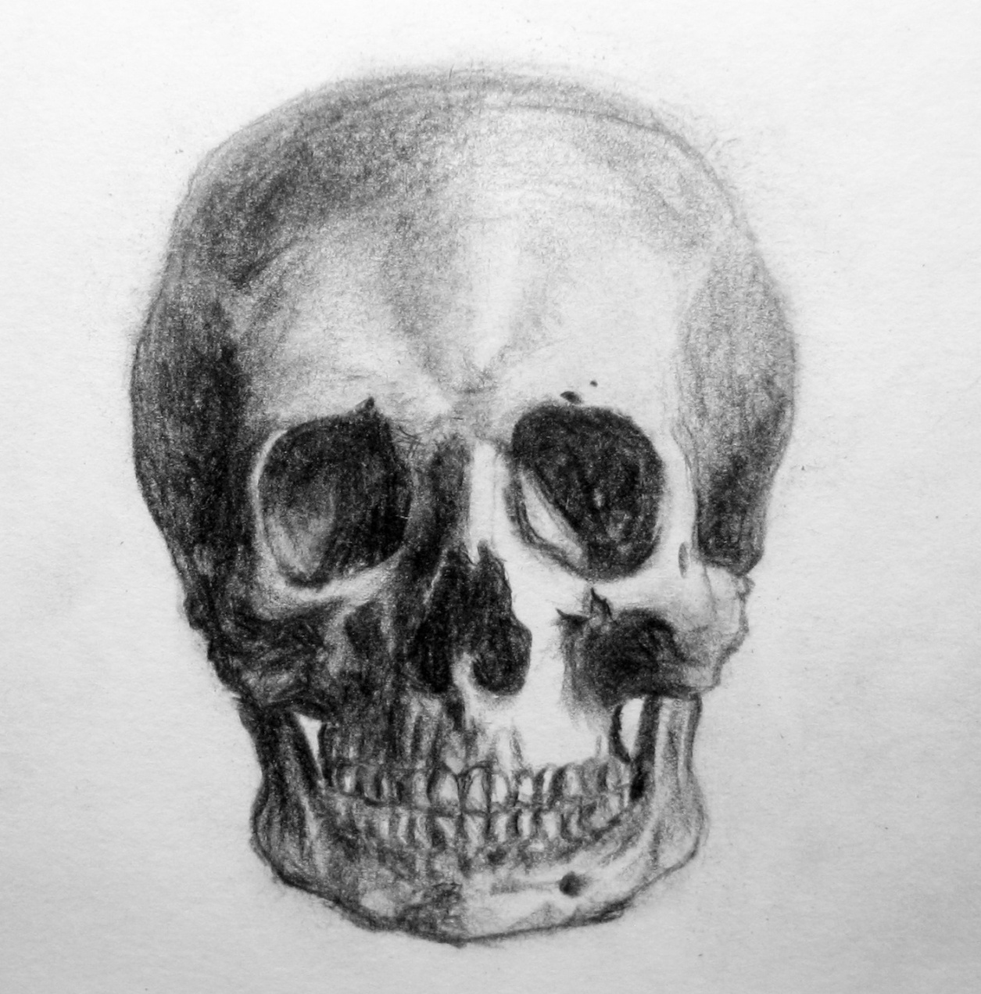
Pencil Drawing

Slide 16
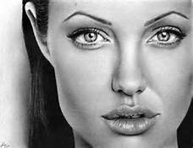
Pencil Portrait

Slide 17
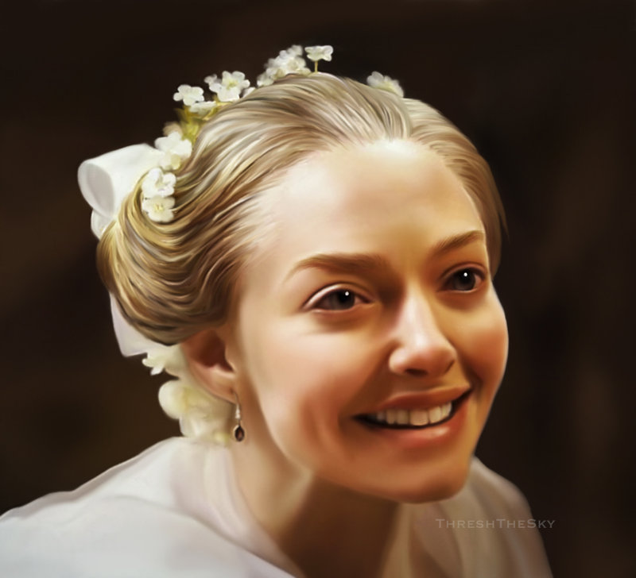
photo of Cosette-Les-Miserables

Slide 18
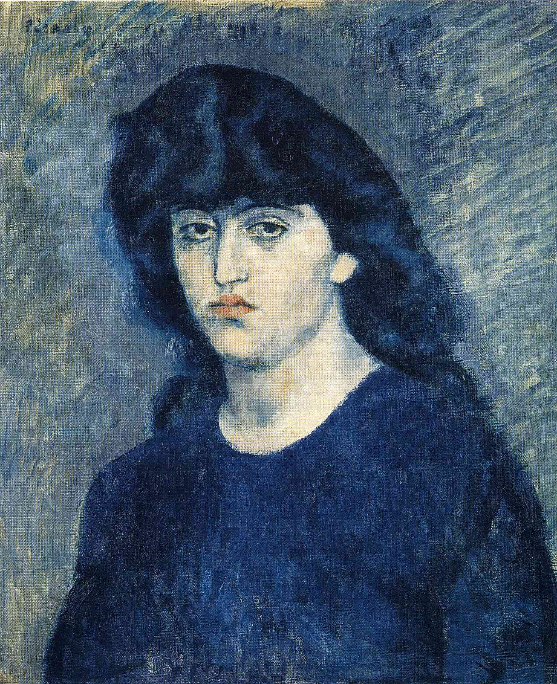
Picasso – Blue Period -Portrait-of-Suzanne-Bloch-1904

Slide 19
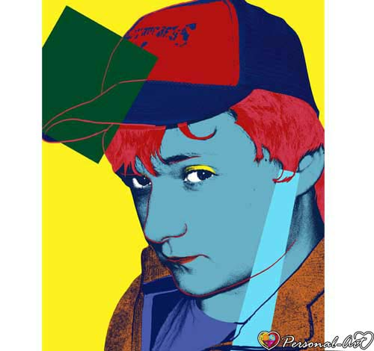
Sample-Genuine-Warhol-Pop-Art-Portrait

Slide 20
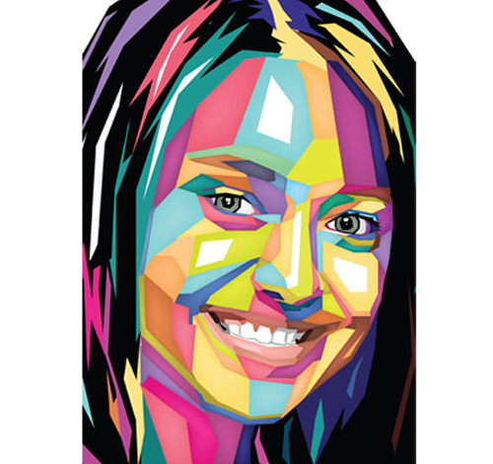
sample-polygones-portrait

Slide 21
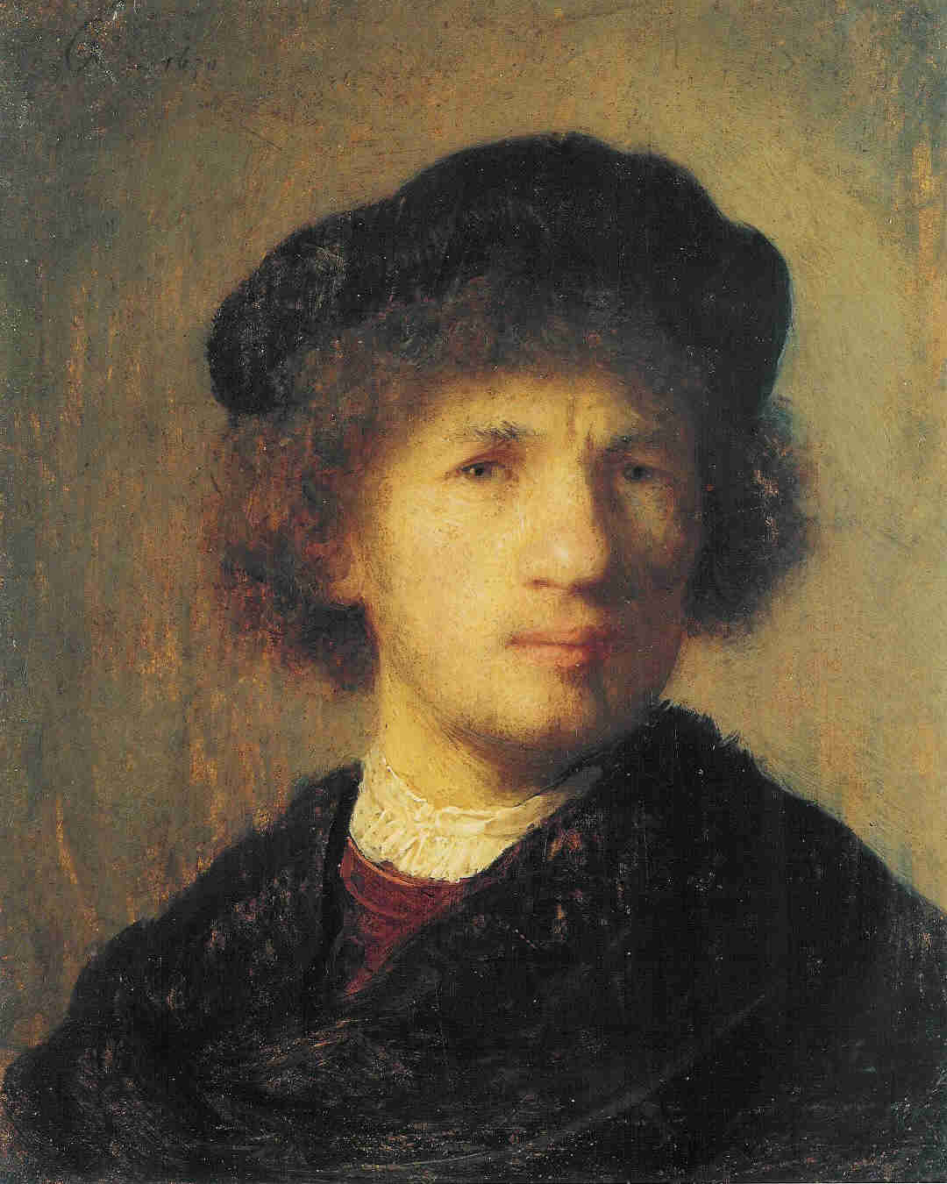
Self Portrait 1630 Stockholm

Slide 22
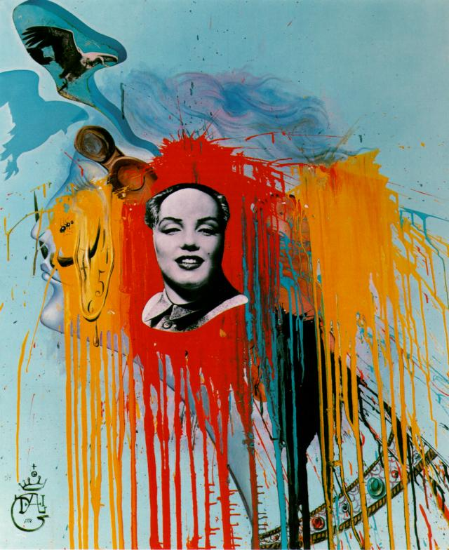
self-portrait- photomontage- with-the-famous- mao- marilyn- that-philippe-halsman- created-at-dali

Slide 23
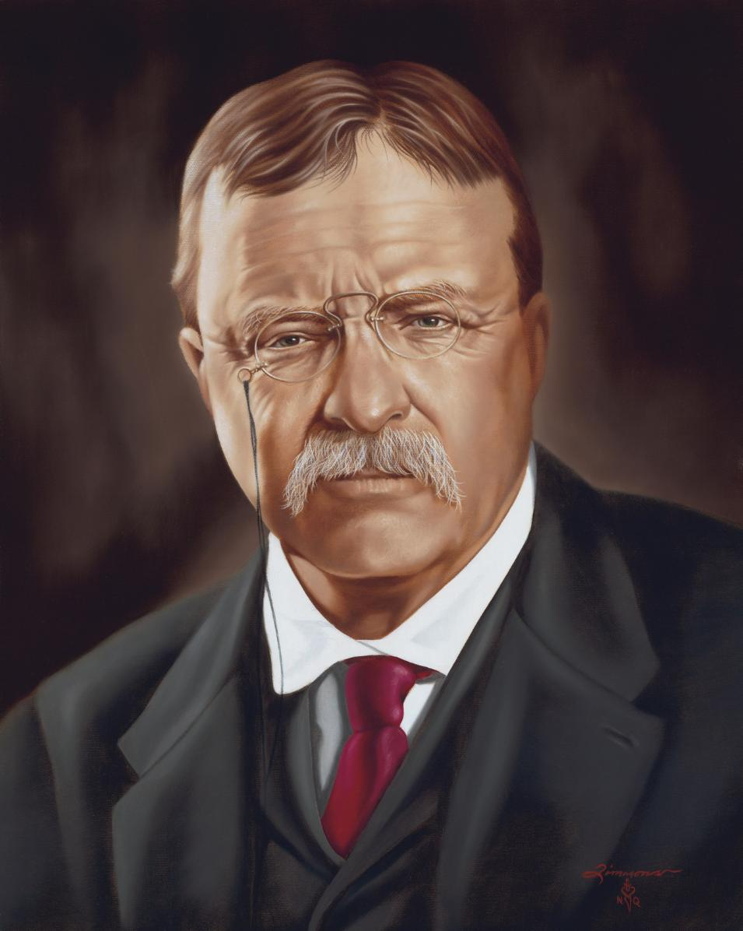
Theodore Teddy Roosvelt

Slide 24
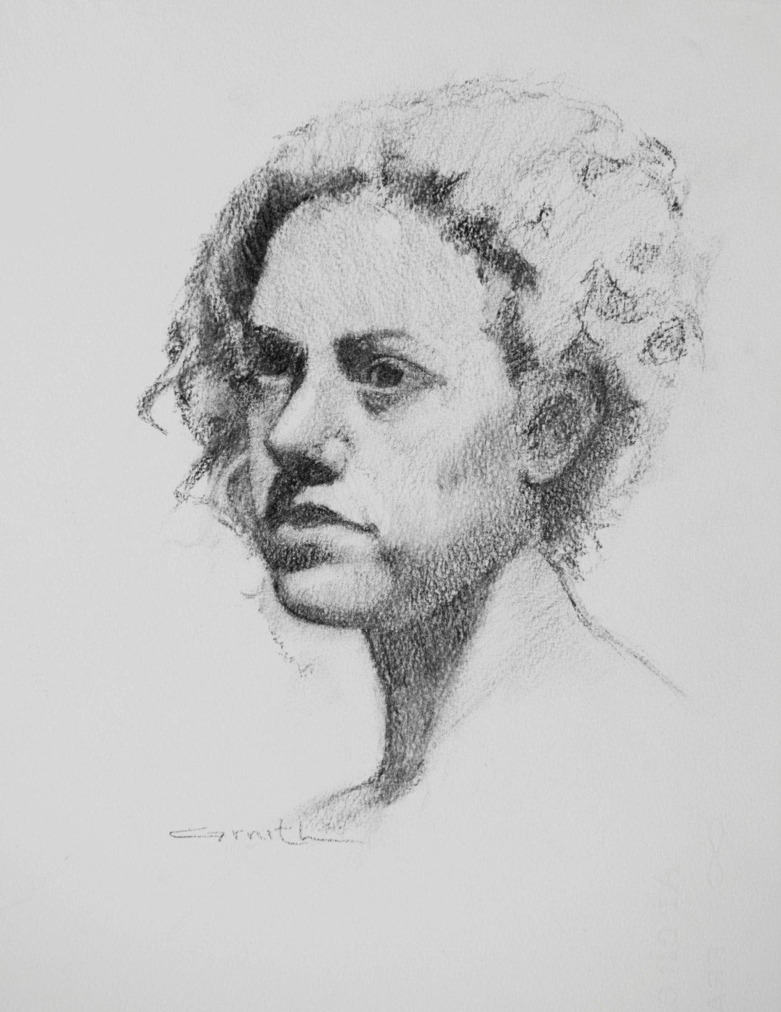
Woman Portrait

Slide 25
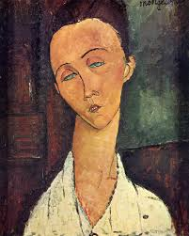
Modigliani

Slide 26
